Slide 1
Rockbuster Stealth
Key findings and actionable recommendations
based on data analysis.
Prepared by: Saba Shakoor
Date: 12-30-2024
Visualization URL: top 10 countries by total customer | Tableau Public

Slide 2
Outline
Introduction
Data Overview
Business Questions and Analysis
Key Findings
Recommendations
Q&A

Slide 3
Introduction
Facing increasing competition from global players and evolving market trends Rockbuster stealth aims to harness data insights to identify key trends, optimize strategies, and address critical challenges. This analysis focuses on understanding customer behavior, revenue distribution, and geographic performance to support strategic decision-making. By leveraging advanced data analysis techniques Rockbuster stealth is positioned to enhance operational efficiency and maximize revenue growth in a competitive landscape.

Slide 4
Data OVERVIEW
Customer Data
Film Data
Geographic Scope
599 records with details such as customer demographics, location, and activity status.
1,000 records spanning various categories, ratings, and pricing details.
Data covers 109 countries with insights into top-performing regions and cities.
Limitations:
The dataset is confined to transactions from February 2006 onward.
All films are in English, which may limit insights into non-English-speaking markets.
The completeness of data relies on accurate recording during the specified period.

Slide 5
Business Questions and Analysis
Which regions generate the most revenue? India, China, and the USA emerged as the top revenue-generating regions, with India
leading at $6,034.78.
What are the characteristics of top customers? Top customers are concentrated in major cities like New York and London, with a high
lifetime value.
How do sales vary across categories and regions? PG-13-rated movies contributed the most revenue across all regions, demonstrating
their universal appeal.

Slide 6
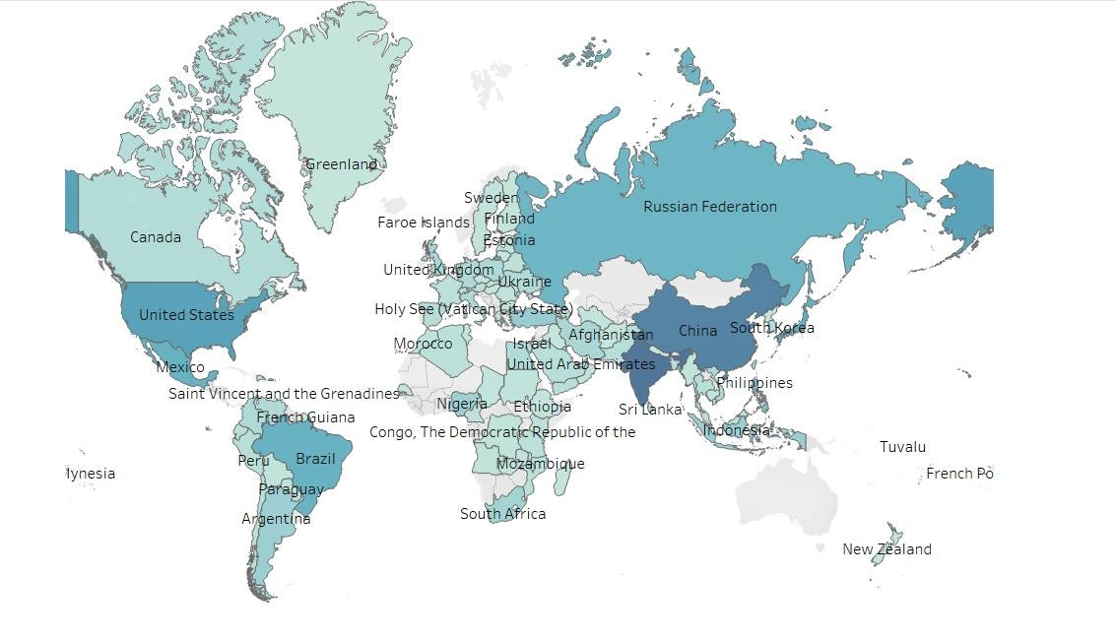

Key findings Geographic Insights
USA, China, and India are the top-performing countries contributing the highest revenue.
Most revenue comes from Asia and North America.

Slide 7
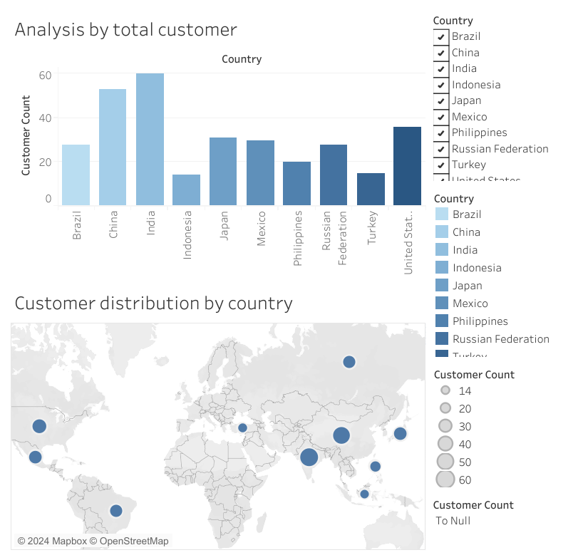
Top 10 countries by total customer
India, China, and the United States have the highest customer counts, making them key markets for Rockbuster's growth. The map shows significant customer concentration in Asia and the Americas, highlighting opportunities to expand in regions like Brazil, Mexico, and Japan.

Slide 8
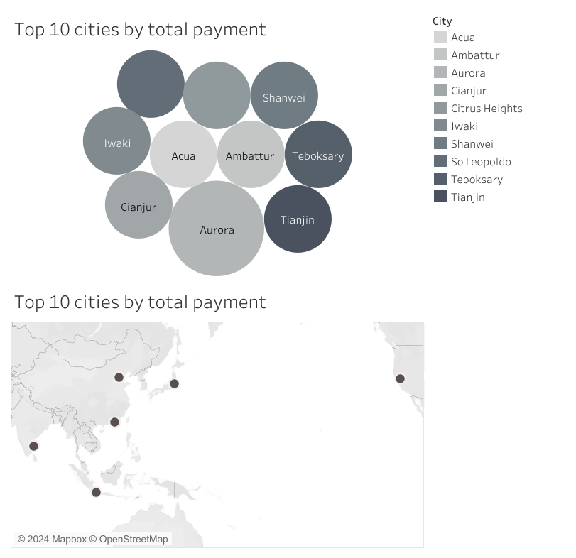
Top 10 cities by total payment
This represents the top 10 cities by total payment. Aurora leads with the highest total payment, followed by cities like Shanwei and Tianjin. Most cities in the top 10 are located in Asia, highlighting significant revenue contributions from this region. This data suggests focusing marketing efforts on these high-performing cities to maximize revenue.

Slide 9
Key figures
Top Countries
Top cities
Top customer
Aurora (USA): $128.70
Sivas (Turkey): $108.75
Celaya (Mexico): $102.76
Sara Perry (Mexico, Atlixco): $128.70
India: 60 customers
China: 55 customers
Brazil: 50 customers

Slide 10
Overall Insights
Top Countries by Customer Count:
India leads with 60 customers, followed by China (55) and Brazil (50).
These three countries make up a significant portion of Rockbuster's customer base, highlighting their importance in the market.
Customer Distribution:
The top 10 countries collectively account for over 70% of Rockbuster's total customers.
There is a strong concentration of customers in Asia and the Americas, as seen in the geographical distribution.
Top Cities by Revenue:
The city of Aurora (USA) generated the highest total payment, with $128.70.
Other notable cities include Sivas (Turkey, $108.75) and Celaya (Mexico, $102.76).

Slide 11
Recommendations
Focus marketing campaigns and promotional activities toward high-revenue regions such as India, China, and the USA to maximize returns.
Invest in top-performing categories like PG-13 movies, which contribute significantly to revenue, ensuring adequate availability to meet demand.
Identify and phase out underperforming products to reduce operational costs and optimize resources.
Allocate more resources to online platforms and streaming services, capitalizing on the growing demand for digital content and expanding audience reach.

Slide 12
q/a

